Slide 1
Staying Involved: Transitioning from an Athlete to an Official
[Enter Local Association Name, Date]

Slide 2
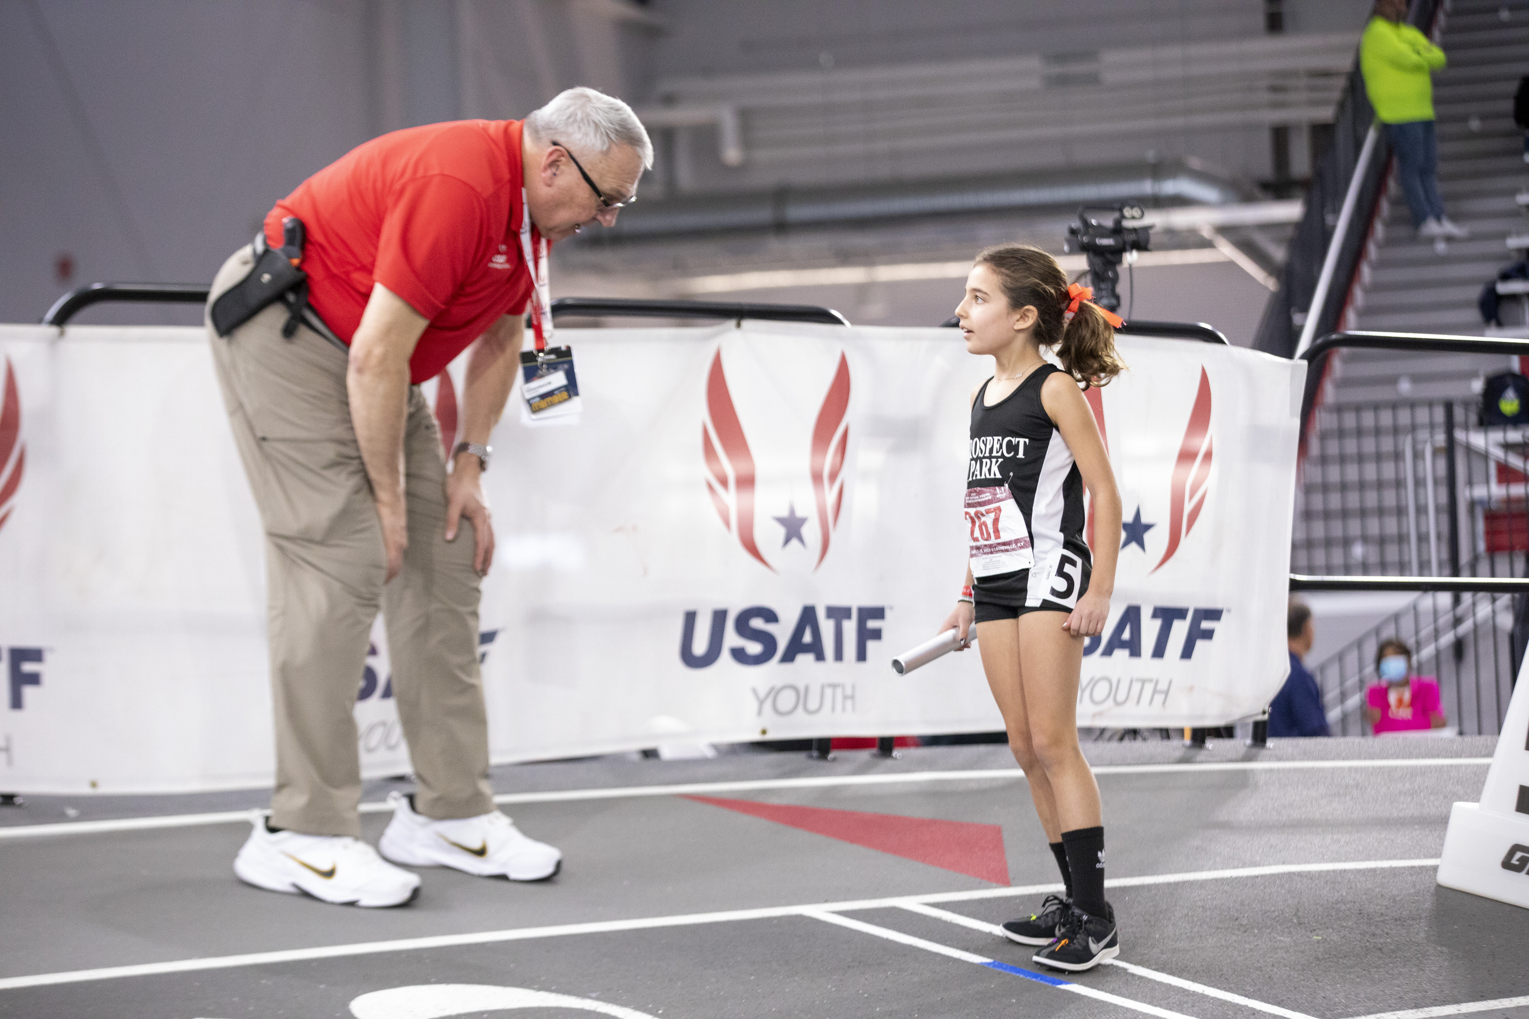
Become a USATF Certified Official
USA Track & Field needs you!
Officiating is a great way to stay involved with the sport
Without officials a meet cannot take place
The number of certified officials has generally been shrinking, and the average age is increasing

Slide 3
Become a USATF Certified Official
Athletes make great officials
You are already know and love the sport
You know how to create an environment to support athlete success
You know the value of a fair and safe competition

Slide 4
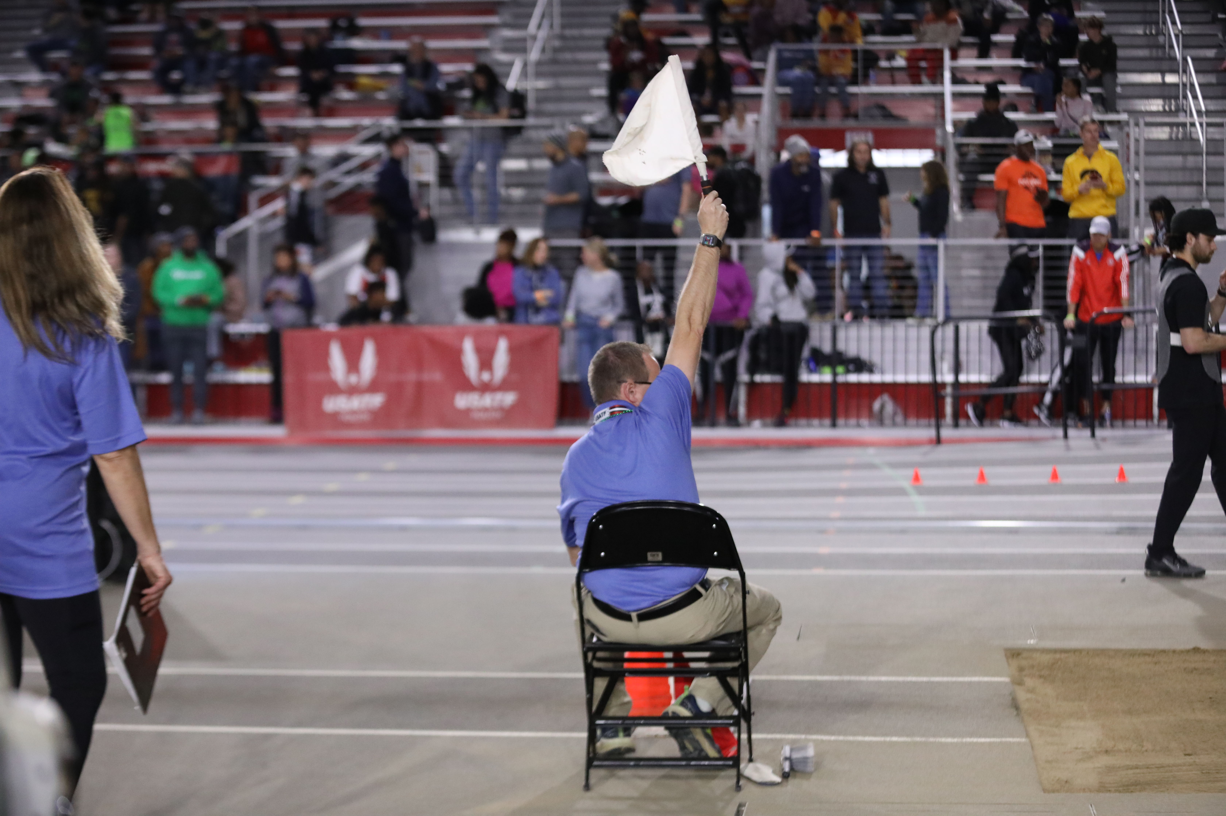
Become a USATF Certified Official
Making the transition from athlete to official is super common
In a recent survey of over 1,000 USATF Certified Officials
Approximately 25% began officiating between the ages of 18-29
Nearly 40% were former track and field athletes

Slide 5
Become a USATF Certified Official
Benefits to Becoming an Official
Stay involved with the sport you love
Lifelong friendships
A chance to give back to the sport
Access to a network of over 4,000 certified officials
The best seat in the house
Access to training and Best Practices
Opportunity to develop and build skills
Insurance coverage
Potential to officiate at USATF Championships and other major meets

Slide 6
Become a USATF Certified Official
What Does a USATF Certified Official Do?
Help create an environment where athletes (youth, open, and masters) can achieve their best performances, in a safe and fair competition
No matter your experience, skill, or interests, there is an officiating role for you
Field Judge(jumps and throws), Umpire, Starter, Clerk, Marshal, Race Walk Judge, Combined Event Coordinator, Referee

Slide 7
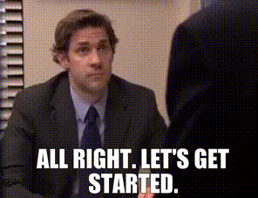
Become a USATF Certified Official
I’m Interested. What Now?
Your local USATF Association Certification Chair can get you started and help guide you through the process
Your local USATF Association Certification Chair is:
[Enter Certification Chair name]
Email: [Enter Certification Chair email]
Phone: [Enter Certification Phone #]

Slide 8
Become a USATF Certified Official
The Process
Contact [Enter Certification Chair name], USATF [Enter Local Association Name] Certification Chair
Become a USATF member*
Complete Background Check*
Complete Safe Sport Training*
Complete the USATF Officials Application**
Complete the Rules Review**
*via USATF Connect
**via USATF Website
The process typically takes 2-4 weeks.

Slide 9
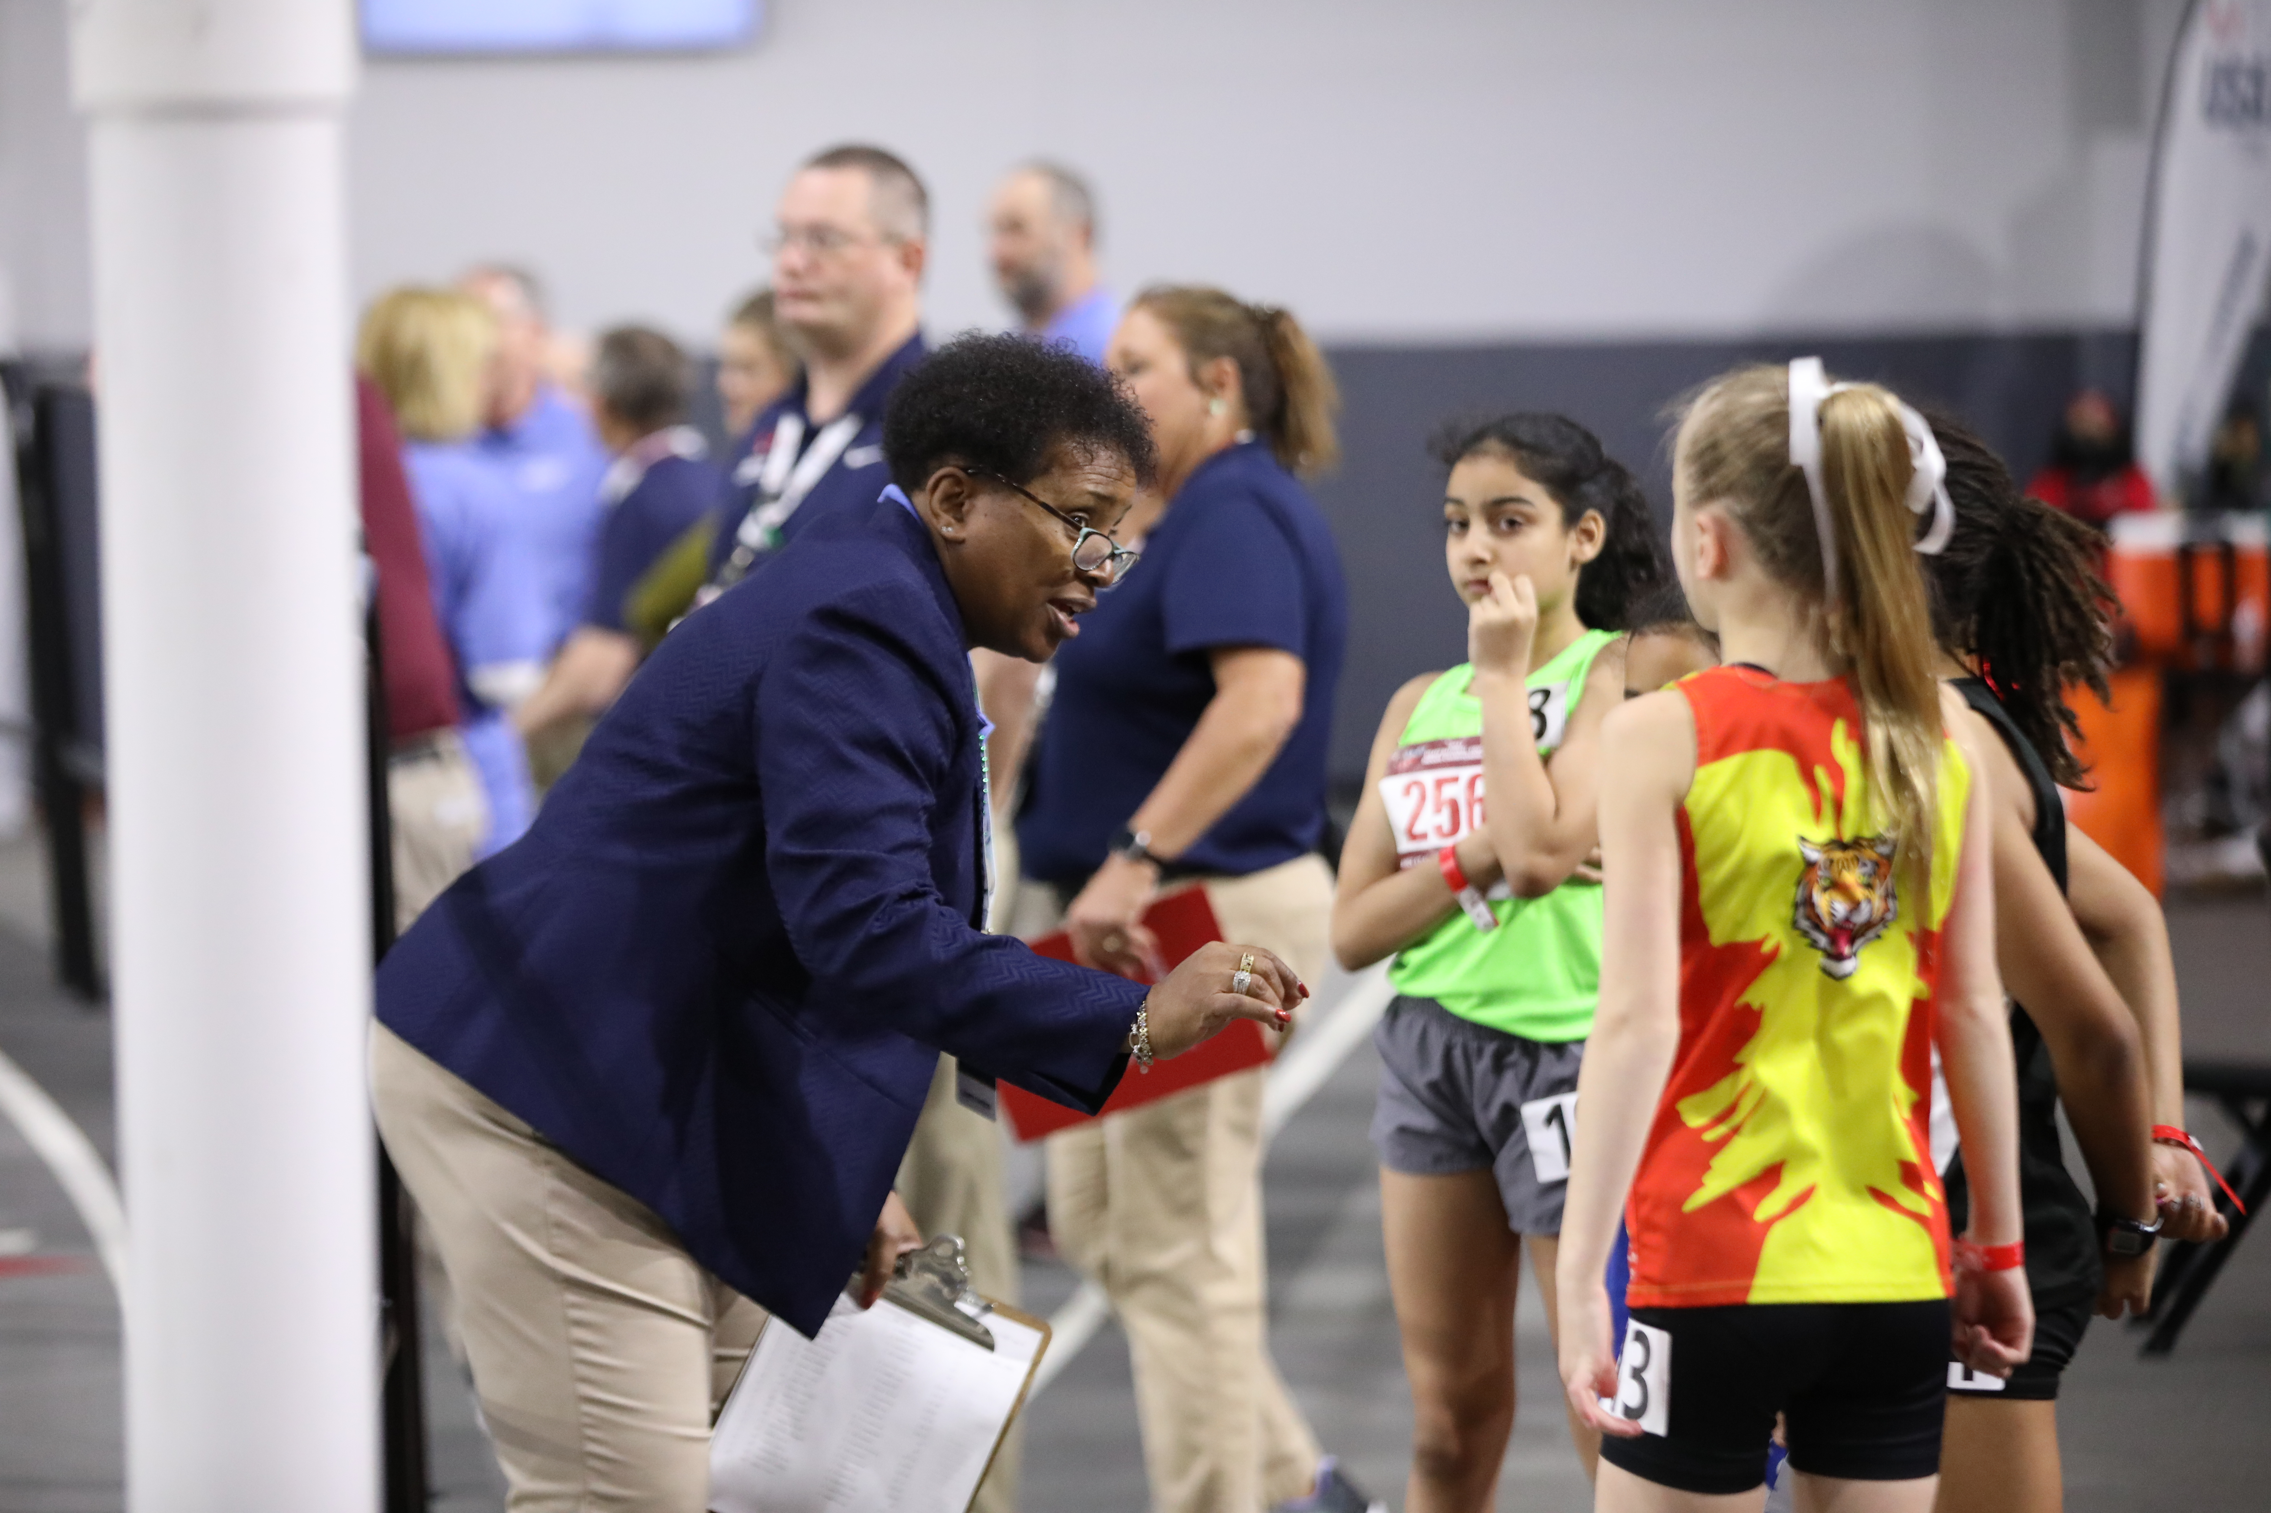
Become a USATF Certified Official
The Program
Structured Progression
Apprentice Level
Association Level
National Level
Master Level
Support and Resources
Local USATF Association Certification Chair
Mentors
Training Clinics
Best Practices Library
New Officials’ Town Hall and Officials’ Oval Table Zoom Meetings
NOC Newsletter

Slide 10
Become a USATF Certified Official
Key Takeaways
The sport needs you!
Your experience as an athlete translates well and will help you stay involved in the sport
You will make lifelong friends – the track & field community is made up of good people
You have the opportunity to contribute to some of the best track and field performances in the country
Next Step
Contact [Enter Certification Chair Name], USATF [Enter Local Association Name] Certification Chair
Email: [Enter Certification Chair email]
Phone: [Enter Certification Phone #]

Slide 11
